Slide 1
BAR
15.S04 SSIM: Hands-On Deep Learning
X-TRACT
From vertical bar plots to tabular data
Group A.7
Ayush Shukla
Dafne Badilla
Gavin Findlay
Rachit Jain

Slide 2
table of contents
01
02
03
PROBLEM STATEMENT
data
OUR MODEL
04
05
RESULTS
NEXT STEPS
Democratizing access to data visualizations
Plots examples
How our pipeline is solving this for vertical bar charts
Performance for each of our 5 models
You can describe the topic of the section here

Slide 3
01
PROBLEM STATEMENT
Most of STEM educational materials are inaccessible for millions of students with learning, physical, or visual disabilities.
Benetech - Making Graphs Accessible. Kaggle competition.

Slide 4
TRAIN/TEST
02
DATA
Overall plots - 60,578
Vertical Bar Charts -19,189

Slide 5
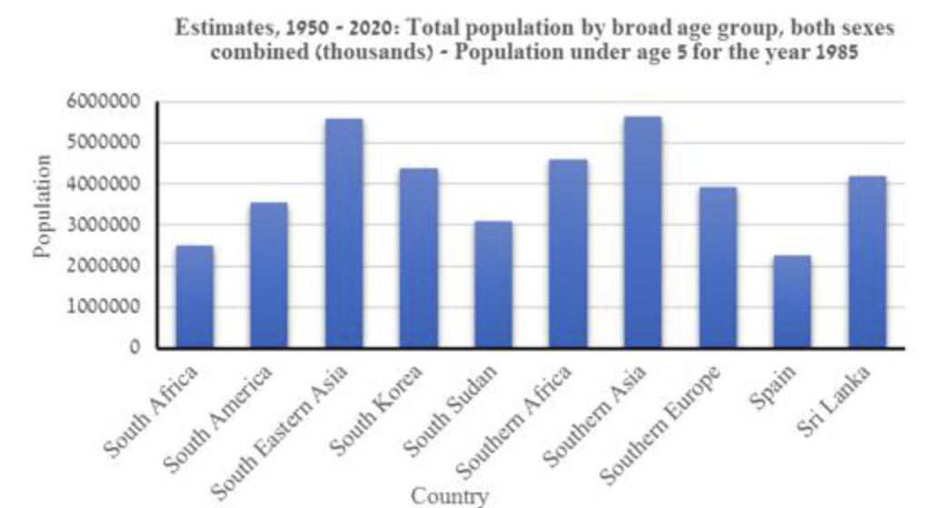
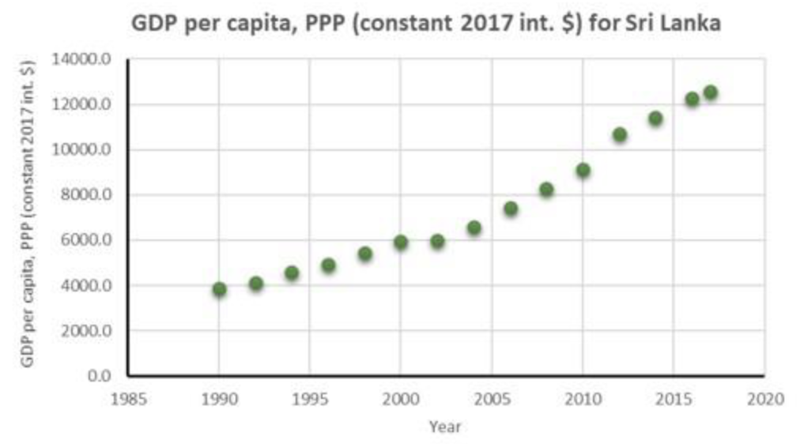
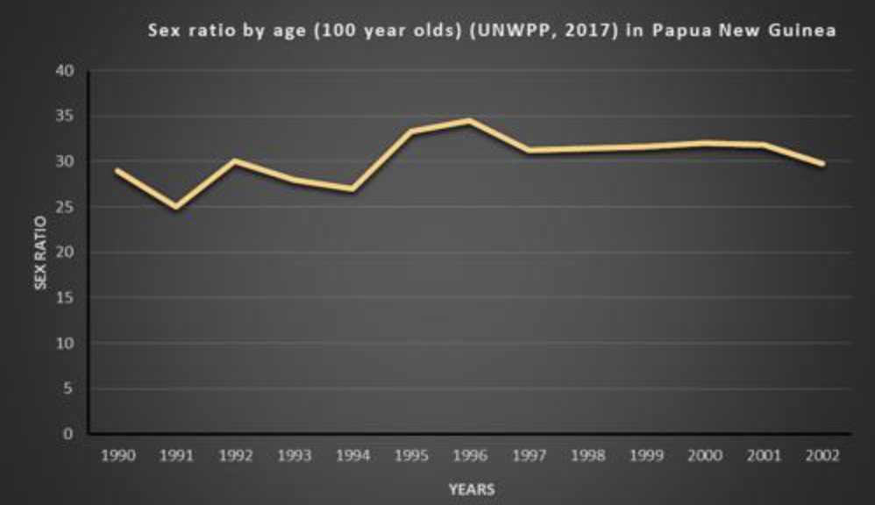
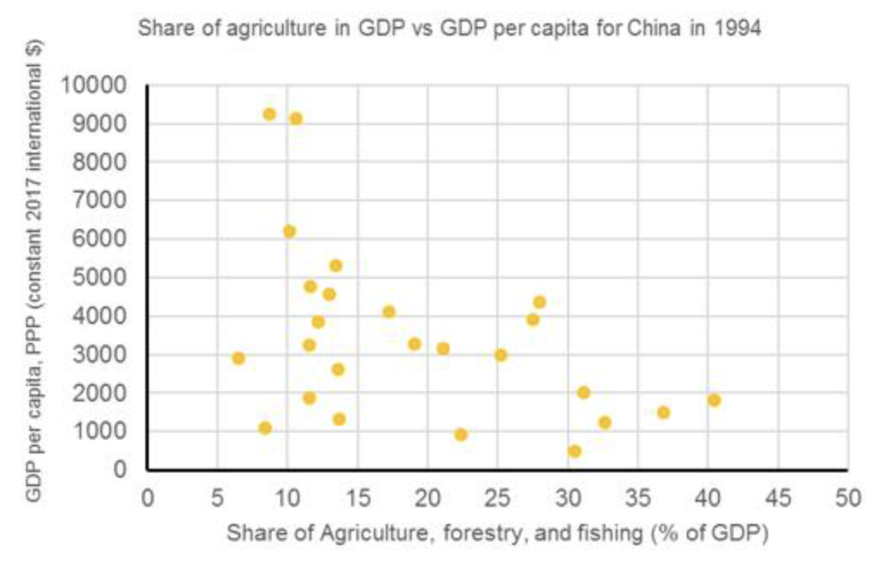
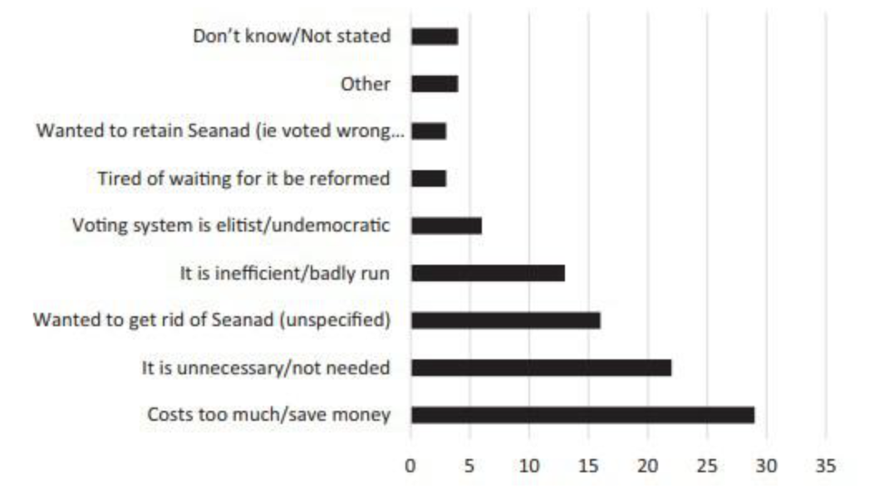
TRAIN/TEST
Relevant remarks
images
annotations
02
DATA
Train/Test split - 80/20
Stratified split to ensure class balance
JPG plot images
Several sizes and hues
Each image has a JSON file with parsed information on:
Chart type
Bounding boxes (plot, text, ticks marks…)
Data points
etc…

Slide 6
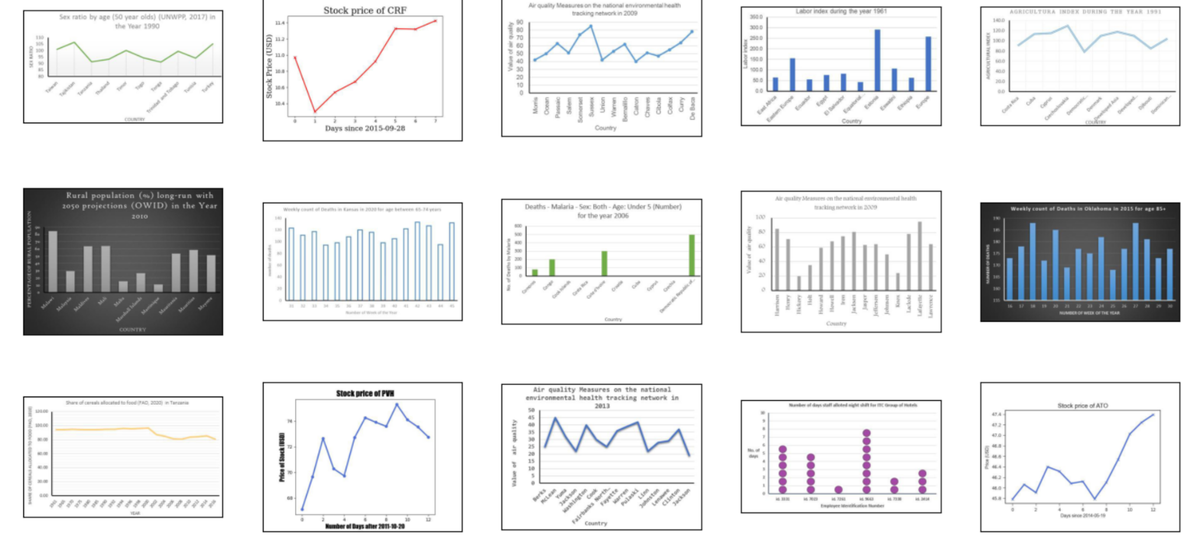
TRAIN/TEST
DATA

Slide 7
OUR
03
MODEL
Predict the data series represented by vertical bar charts

Slide 8
our
BOUNDING BOXER
cHART CLASSIFIER
TICK extractor
EDGE DETECTOR
TEXT rECOGNITION
(x,y)
03
MODEL
Identifying axis intersection
Identifying 5 types of charts
Focusing on axis scale detection
Extracting bar heights
Bounding boxes + OCR

Slide 9
Bounding Boxer
Chart Classifier
Origin Detector
Text Recognition
Tick Extractor
Edge Detector

Slide 10
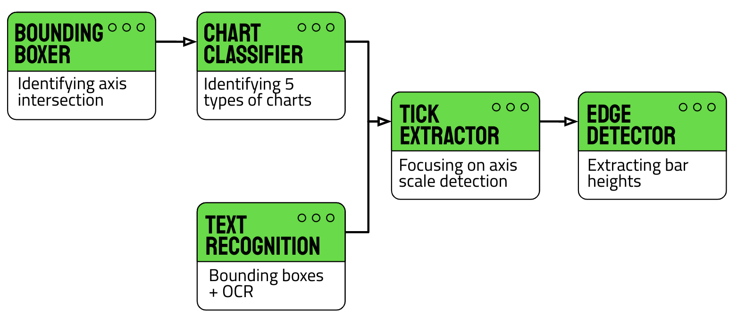
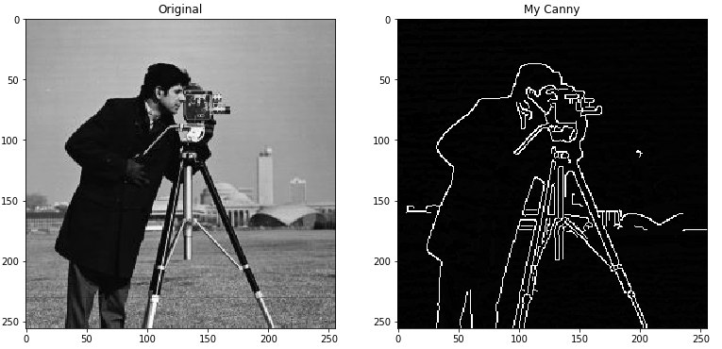
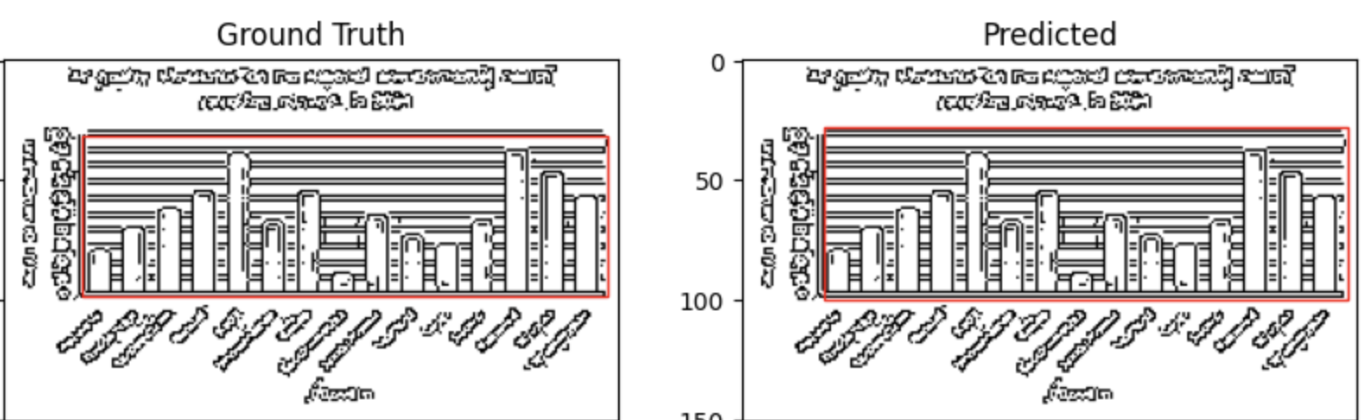
our
BOUNDING BOXER
Model Type
INPUT
OUTPUT
MODEL
03
Canny edge detection to denoise image and extract vital details
Finding intersection point of edges
The original graph image which is padded into a square for CNN
Ground Truth
Predicted
Coordinates for origin, height and width of bounding box around chart
Image cropped to bounding box for improved chart classifier
Fig: Ground truth bounding box and model prediction of chart after canny edge detection

Slide 11
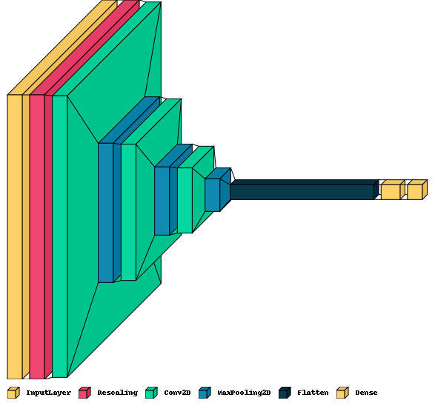
our
cHART CLASSIFIER
Model Type
INPUT
OUTPUT
MODEL
03
CNN to classify image into one of the five chart categories
Experimented with wider and deeper models
Cropped image from origin of bounding box to image borders
One of five chart labels
Train accuracy: 1.0
Test accuracy: 0.9966

Slide 12
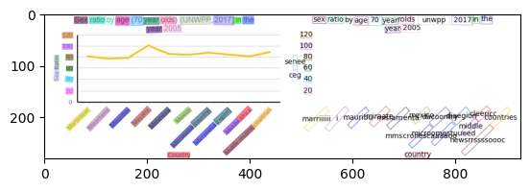
our
TEXT recognition
Model Type
INPUT
OUTPUT
MODEL
03
Employed pre-trained models to tackle this problem
DBNet to locate text and bound text boxes
ABINet to extract text value
The original graph image, no cropping
Bounding box around all the text
Text values

Slide 13
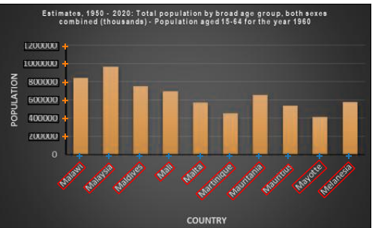
our
TICK extractor
Model Type
INPUT
OUTPUT
MODEL
03
Use bounding box to identify text associated with ticks
Identify if text box is flat or slanted
Calculate location of ticks on axis from text box coordinates
Bounding box coordinates for labels
Chart origin (x,y) coordinates
(x,y) coordinates for each x and y axis tick
Value/text associated with each tick

Slide 14

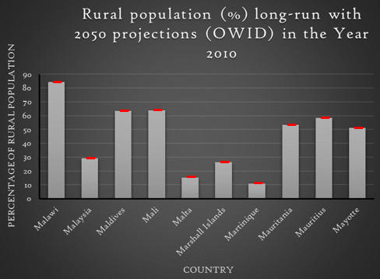
our
EDGE DETECTOR
Model Type
INPUT
OUTPUT
MODEL
03
Horizontal Edge Detector to find the tops of bars
Create binary image to apply gradient on
Use y-coordinates and tick mark locations/labels to estimate numeric value
Bounding box around the chart
Locations for the ticks on X and Y axes
Estimate of the numeric value for each bar in the chart

Slide 15
04
OUR
RESULTS

Slide 16
our
Bounding
Boxer
Chart
classifier
TICK EXTRACTOR
EDGE DETECTOR
TEXT recognition
04
RESULTS
Train MAE:
2.97
Test MAE:
3.03
Train Accuracy:
0.9997
Test Accuracy:
0.831
% of ticks labels not detected*:
7.88%
Train RSME:
TBD
Test RSME:
TBD
%age of strings beyond 1 levenshtein distance & unmatching numerals*:
44.71%
Still working on complete pipeline, so results presented are for each submodule

Slide 17
NEXT
05
STEPS
Connect sub-modules into full pipeline
Using a similar approach to address horizontal bar charts
Building models for the remaining types of charts (line, dots, scatter plots)
Win this Kaggle competition ;)

Slide 18
THANKS!
Do you have any questions?

